Slide 1
GIT hub & GIT integration

Slide 2
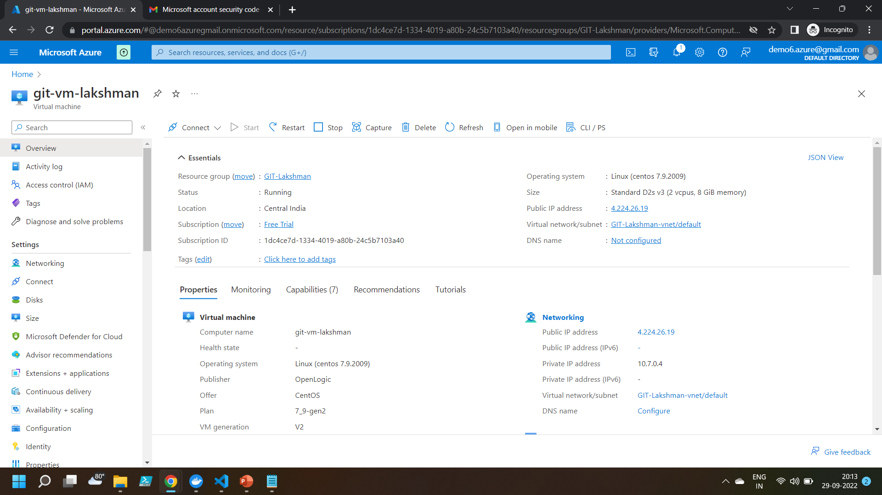
Created a Virtual Machine with Cent OS

Slide 3
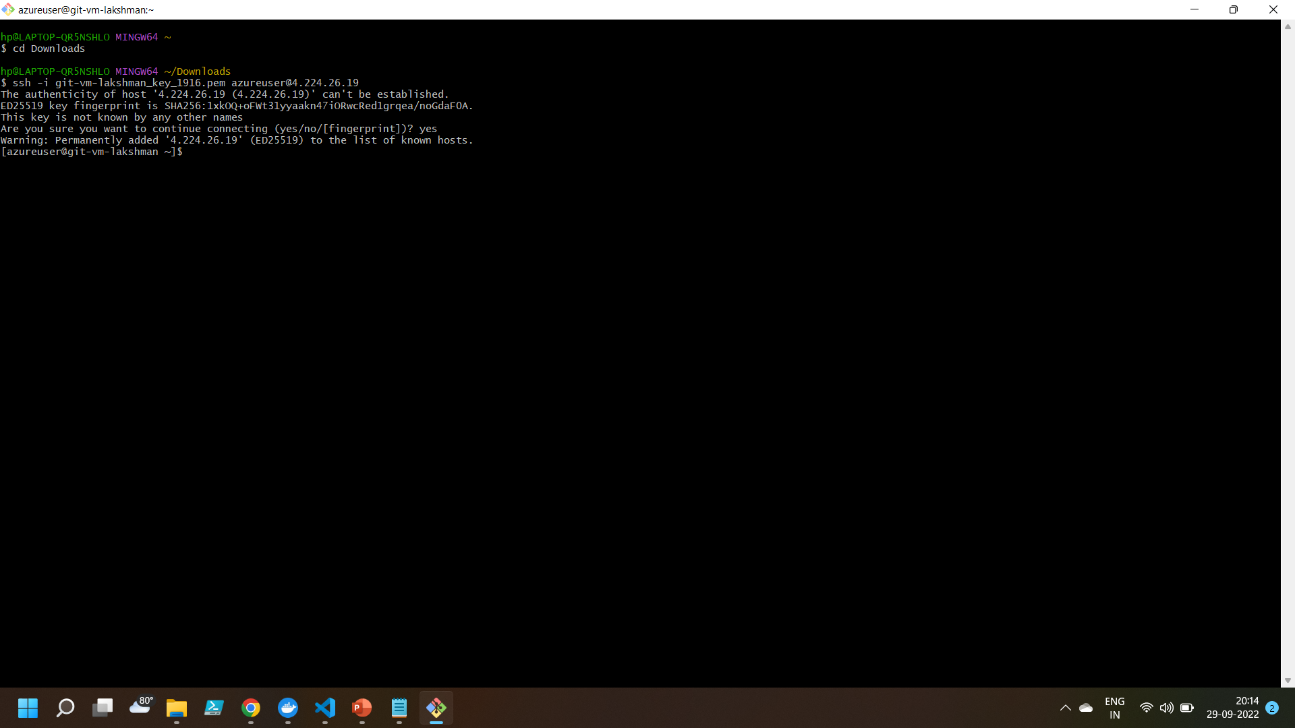
Logged into the VM by using SSH

Slide 4
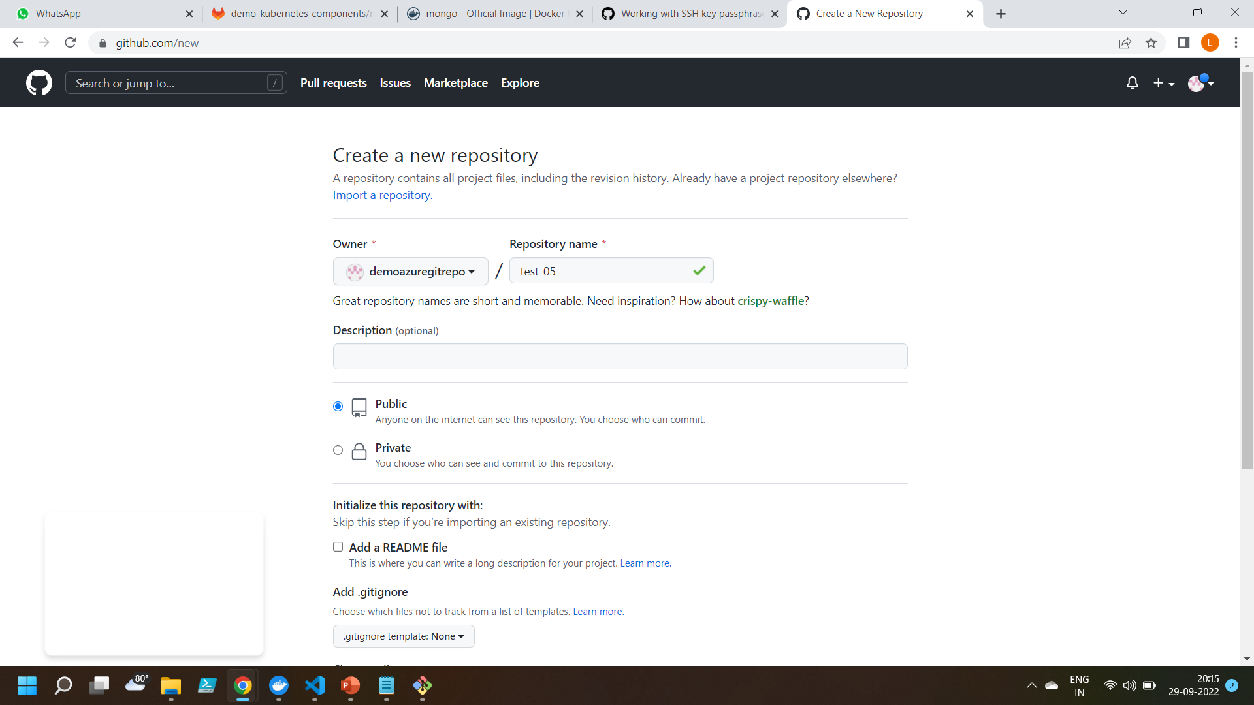
Created a git hub repository

Slide 5
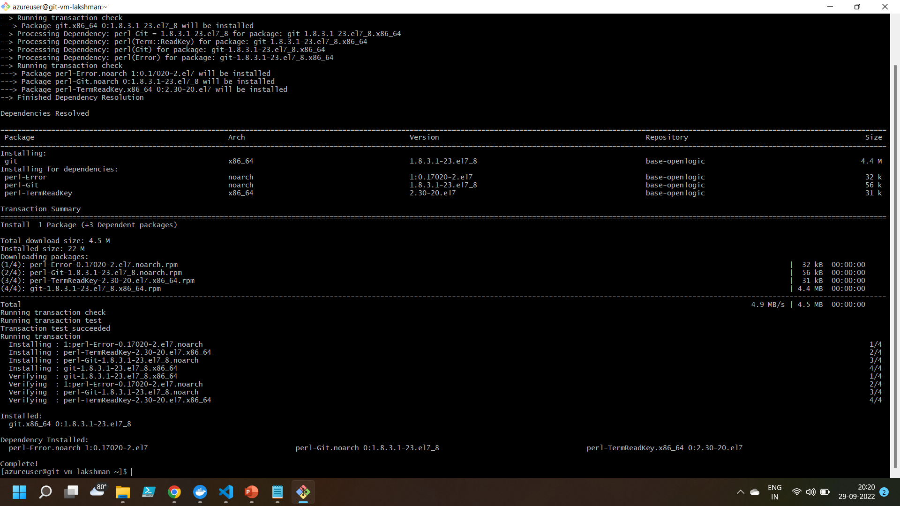
Installing git into the VM

Slide 6
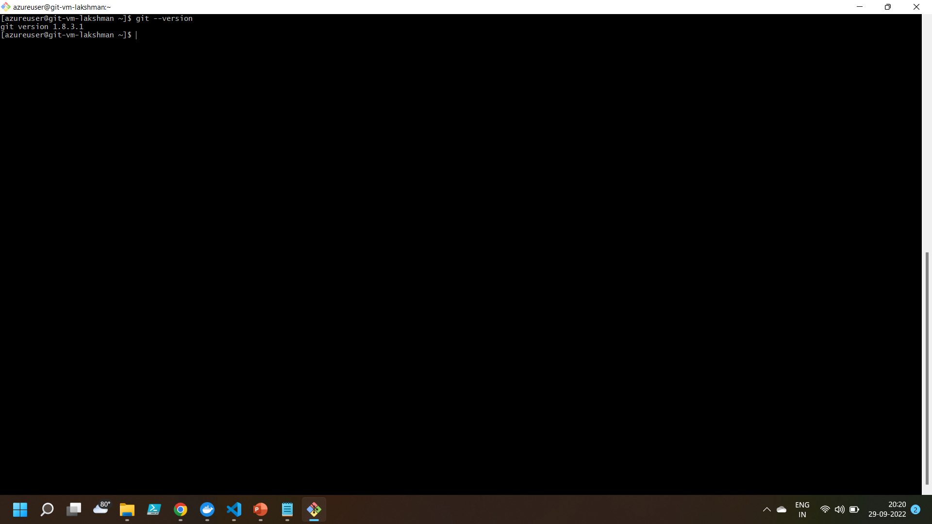
Git Installed

Slide 7

Created main branch using commands

Slide 8
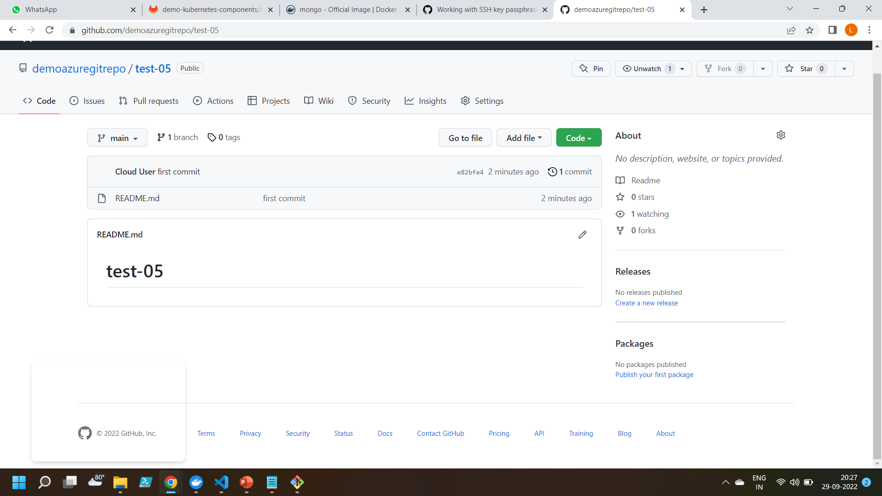
Main branch created

Slide 9
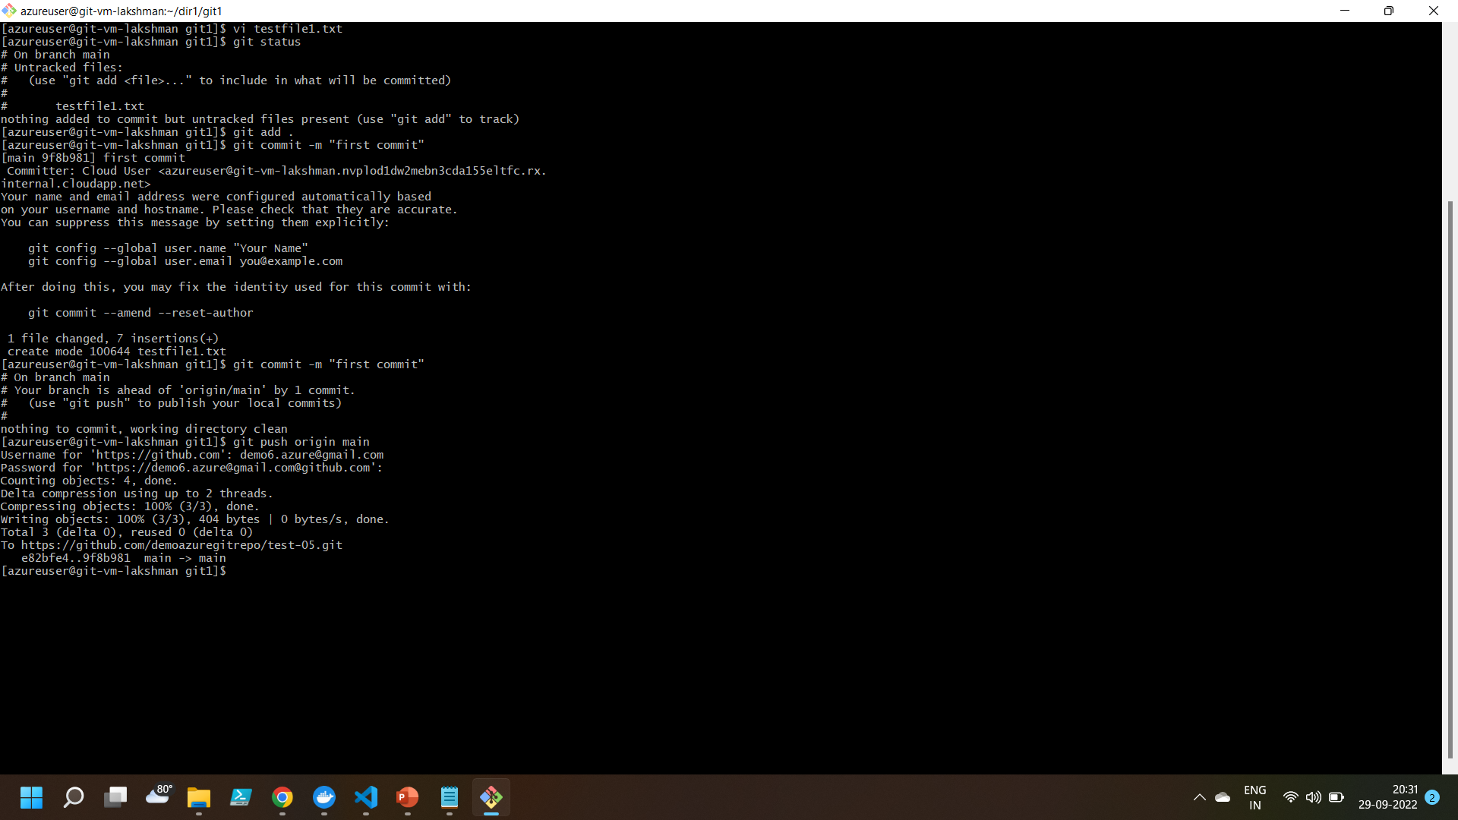
Creating a test file using commands

Slide 10
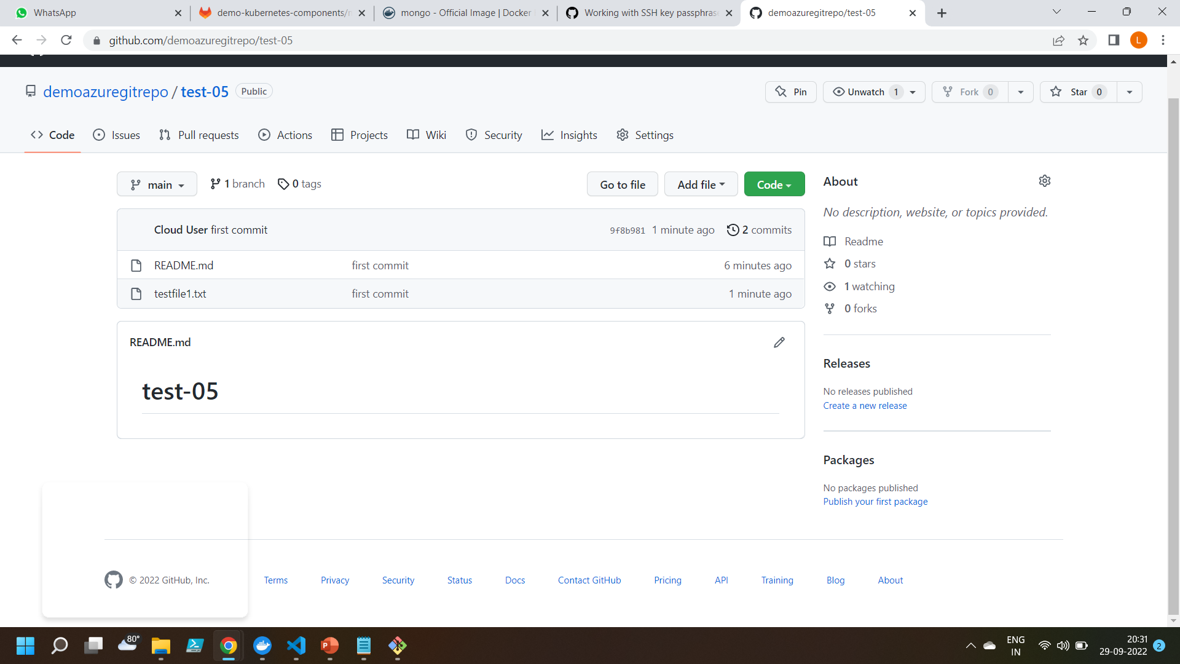
Test file created

Slide 11
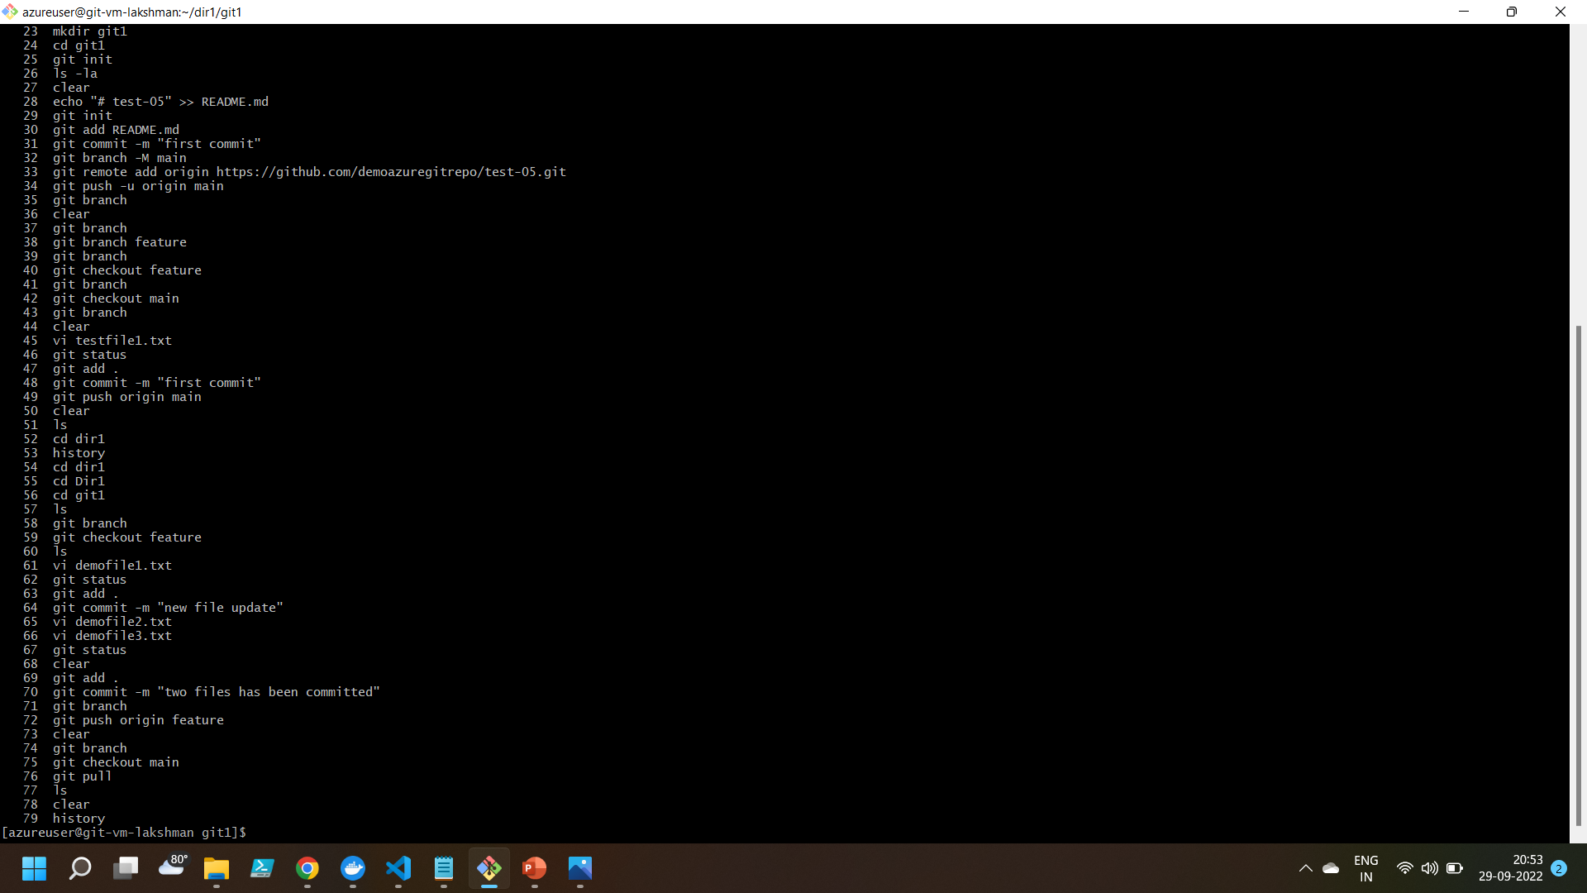
Created some demo files and pushed them into the feature branch

Slide 12
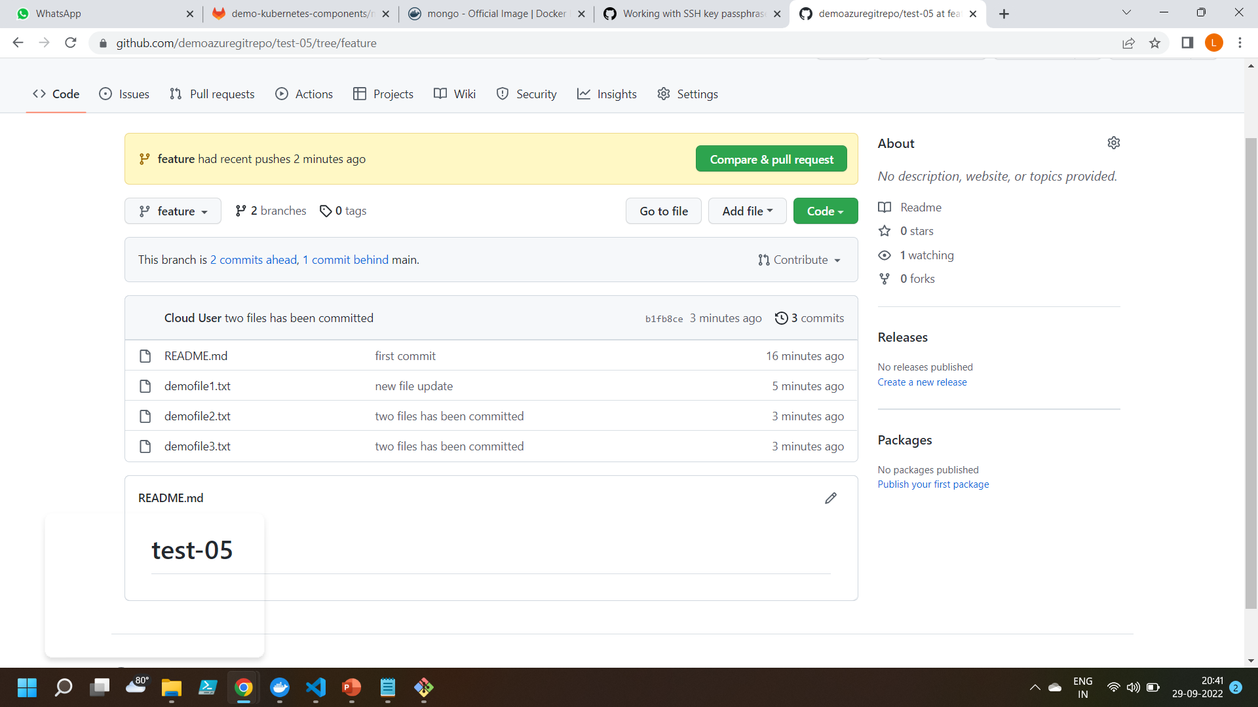
Demo files created

Slide 13
Thankyou

